Slide 1
R
PCA

Slide 2
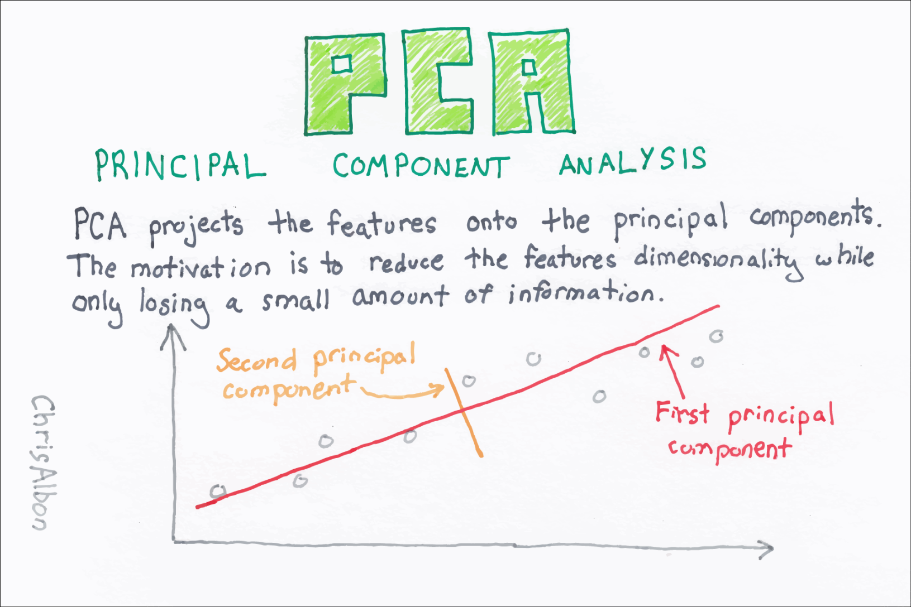

Slide 3
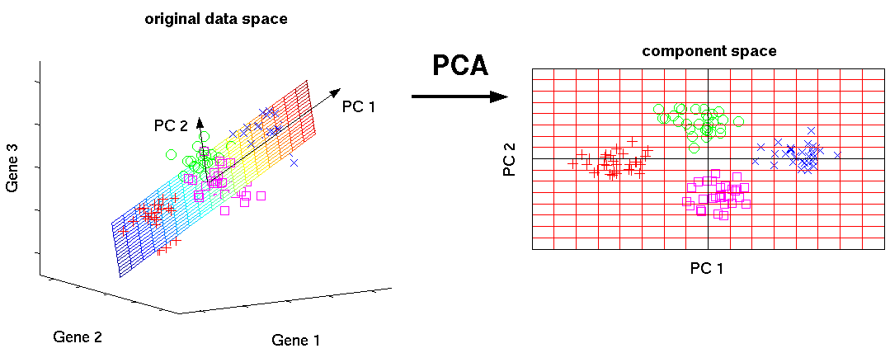

Slide 4
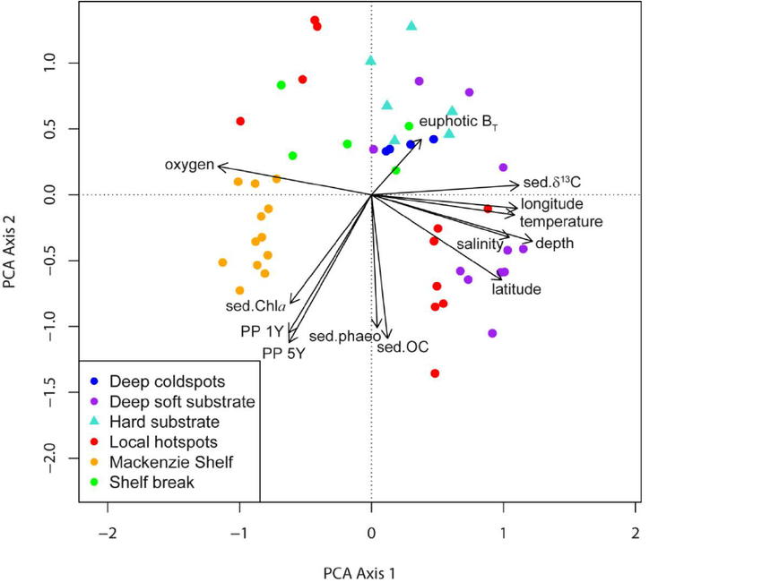

Slide 5
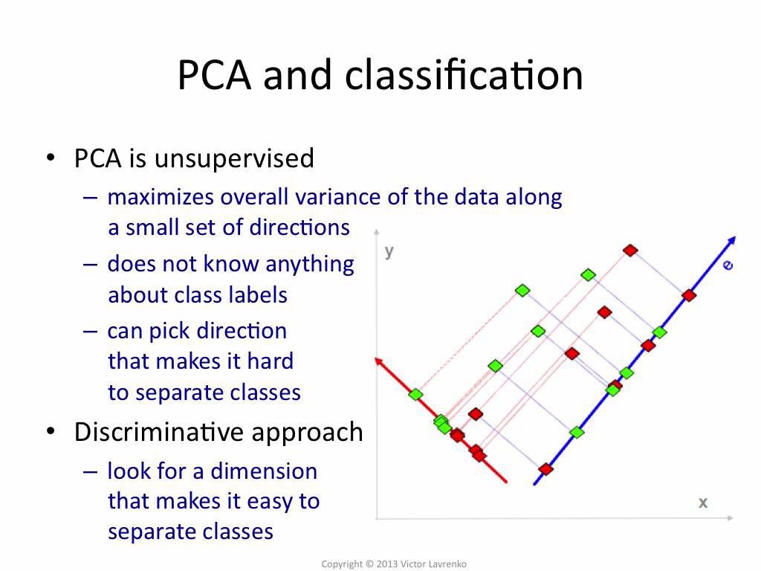

Slide 6
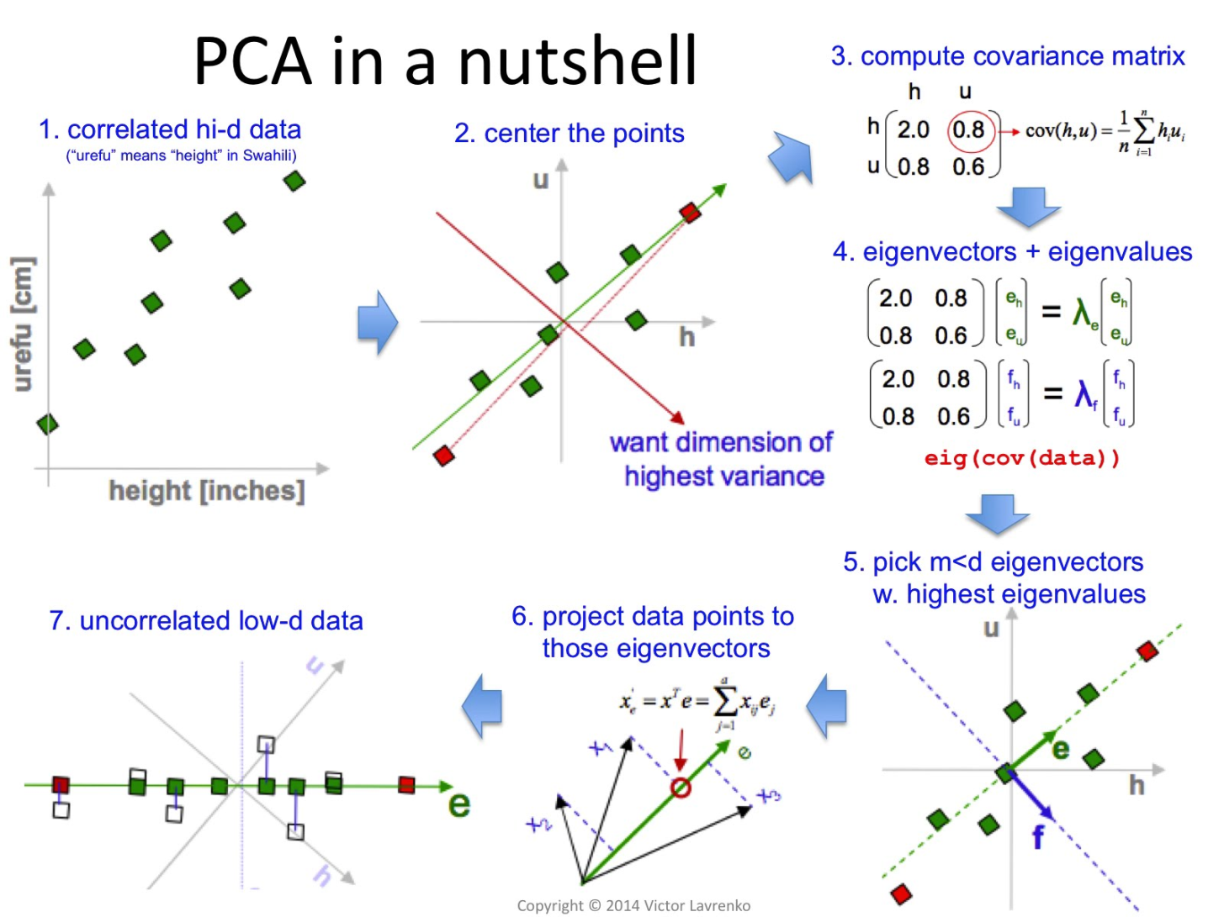

Slide 7
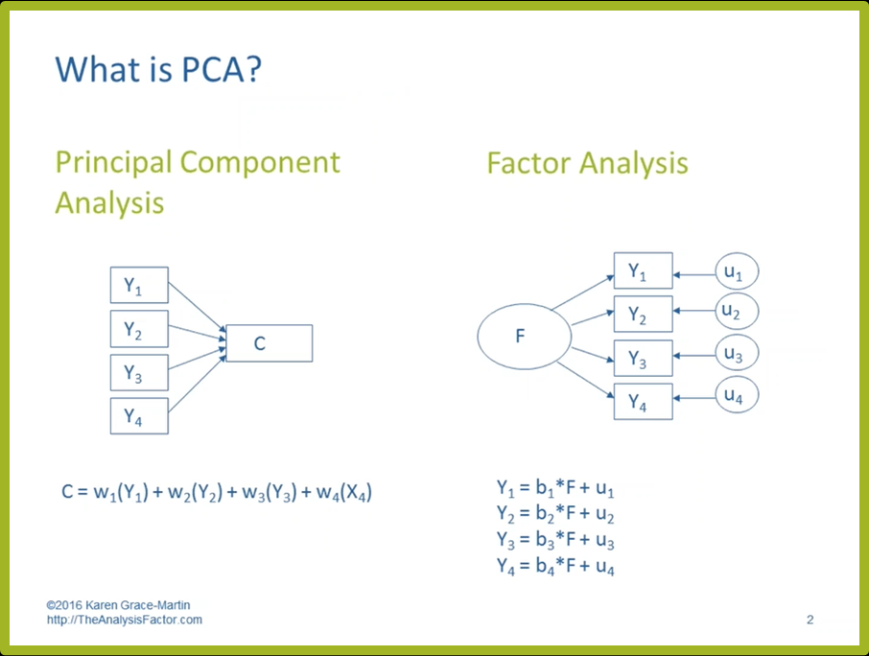

Slide 8
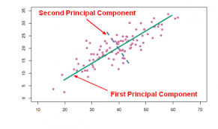

Slide 9
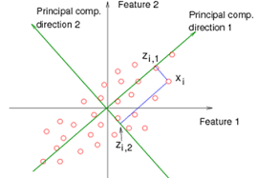

Slide 10
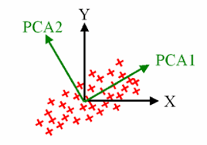

Slide 11
Principal component analysis (PCA) is a statistical procedure that uses an orthogonal transformation to convert a set of observations of possibly correlated variables into a set of values of linearly uncorrelated variables called principal components.
singular value decomposition
factor analysis

Slide 12
PCA is mostly used as a tool in exploratory data analysis and for making predictive models. It's often used to visualize genetic distance and relatedness between populations.
Dimensionality reduction
Covariance

Slide 13
Interpretation
You can use the size of the eigenvalue to determine the number of principal components.
https://support.minitab.com/en-us/minitab/18/help-and-how-to/modeling-statistics/multivariate/how-to/principal-components/interpret-the-results/all-statistics-and-graphs/

Slide 14
You can use the size of the eigenvalue to determine the number of principal components. Retain the principal components with the largest eigenvalues. For example, using the Kaiser criterion, you use only the principal components with eigenvalues that are greater than 1.

Slide 15
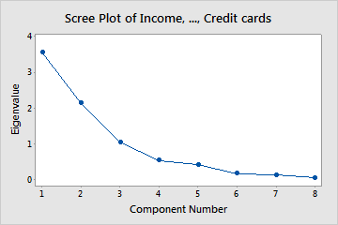
In these results, the first three principal components have eigenvalues greater than 1. These three components explain 84.1% of the variation in the data. The scree plot shows that the eigenvalues start to form a straight line after the third principal component. If 84.1% is an adequate amount of variation explained in the data, then you should use the first three principal components.

Slide 16
Proportion is the proportion of the variability in the data that each principal component explains.
Cumulative

Slide 17
The principal components are the linear combinations of the original variables that account for the variance in the data.
Mahalanobis distance is the distance between a data point and the centroid of the multivariate space

Slide 18
Screeplot
Loadingplot
Biplot
Scoreplot

Slide 19
fit <- princomp(mydata, cor=TRUE)
summary(fit) # print variance accounted for
loadings(fit) # pc loadings
plot(fit,type="lines") # scree plot
fit$scores # the principal components
biplot(fit)

